Slide 1


Adaptive Hybrid Continuous
Behavioral Authentication System
Delta University for Science and Technology
Based on Keyboard and Mouse Dynamics for Real-Time User Verification
Faculty of Artificial Intelligence
Mitigating Deterministic Credential Compromise via Keystroke Dynamics and Kinematic Analysis
Supervisor
Dr. Ali Elsherbeni
Lujain Mustafa Kamel
Mohamed El-Shishtawy
Spring 2025 / 2026
Amr Ashraf Wardento
Omar Essam El-Saidy
Habiba Hamada Abdallah
1 / 32

Slide 2



Problem Formulation
The Fragility of Deterministic Authentication
Static Credential Vulnerability
Point-of-Entry Authentication Gap
Automated Adversary Proliferation
Passwords and PINs are susceptible to brute-force, credential stuffing, and phishing — providing zero post-compromise protection.
Traditional systems authenticate only at login. Post-session hijacking and insider threats remain entirely undetected.
Bots and automated scripts can mimic human login behavior. Dynamic, continuous, non-intrusive verification is now essential.
The proliferation of automated adversaries necessitates continuous intelligent behavioral verification throughout the entire user session.
Traditional Authentication
Our Behavioral System
Authenticate once at login only
Password = sole verification layer
Post-session: ZERO protection
Bot attacks: undetectable
Continuous post-login monitoring
Keystroke + Mouse biometrics
Session hijacking: detected
Bot automation: blocked
VS
2 / 32

Slide 3
Research Objectives
Strategic Objectives of the Proposed Framework
Design and implement a continuous authentication architecture utilizing advanced behavioral biometrics.
Extract and quantify spatiotemporal features from keystroke dynamics and mouse kinematics.
Deploy Isolation Forest (unsupervised ML) to differentiate organic human variance from synthetic bot interactions.
Ensure high concurrency and data integrity via a robust asynchronous database architecture (SQLite via ORM).
Achieve >94% anomaly detection accuracy with <50ms inference latency per operation.
2
>94%
<50ms
Continuous
Behavioral Modalities
Detection Accuracy
Inference Latency
Post-Login Guard
3 / 32

Slide 4


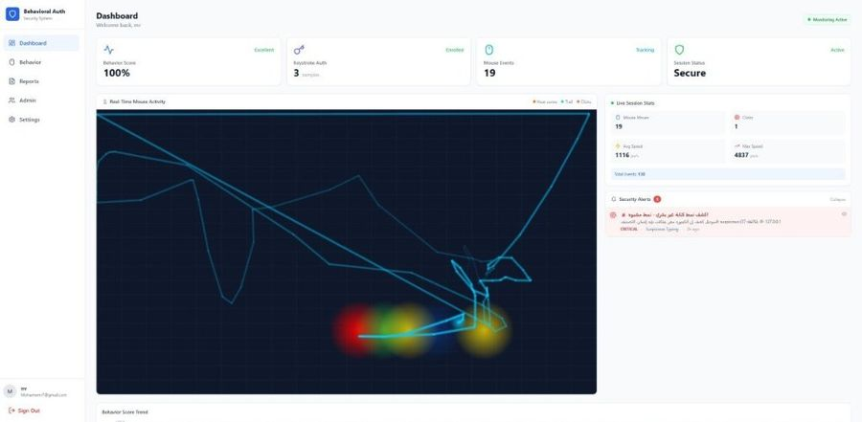


Methodological Scope
System Boundaries and Operational Domain
Domain
Behavioral Vectors
Web-centric environments with client-side asynchronous event tracking via modern browser APIs.
Keystroke events (Dwell/Flight times) and multidimensional mouse trajectories — no physiological biometrics.
Deployment Readiness
Explicit Exclusions
Integrable high-availability API layer capable of interfacing with localized or distributed enterprise systems.
Physiological biometrics (facial/retinal recognition) are explicitly out of scope in this system version.
Live System Dashboard
4 / 32

Slide 5


Conceptual Background
Continuous Authentication via Behavioral Biometrics
Definition: The stochastic measurement of uniquely identifiable human interaction patterns — verifying identity implicitly without querying the user.
Keystroke Dynamics
Kinematic Footprinting
Frictionless Security
Analyzing neurophysiological rhythms inherent to a user's typing cadence — dwell time, flight time, digraph latency patterns.
Leveraging mouse speed, acceleration, and path linearity as distinct biometric signatures unique to each individual.
Zero-friction verification — user identity continuously confirmed in the background without any interaction overhead.
Key Advantages Over Traditional Methods
No Password Required
Continuous All-Session
Non-Intrusive to UX
Bot-Proof by Design
Post-Session Protection
5 / 32

Slide 6
Literature Review & Related Work
Academic Context and Prior Empiricism
Monrose & Rubin (2000)
Established foundational metrics for keystroke dwell and flight time variance in identity verification.
Ahmed & Traore (2007)
Pioneered continuous authentication utilizing mouse dynamics and spatial heat mapping for behavioral profiling.
Liu, Ting & Zhou (2008)
Demonstrated the efficacy of Isolation Forests for high-dimensional anomaly detection in behavioral data.
Our Contribution
Fusing both keystroke and kinematic modalities into a real-time, low-latency pipeline using modern scalable frameworks.
6 / 32

Slide 7
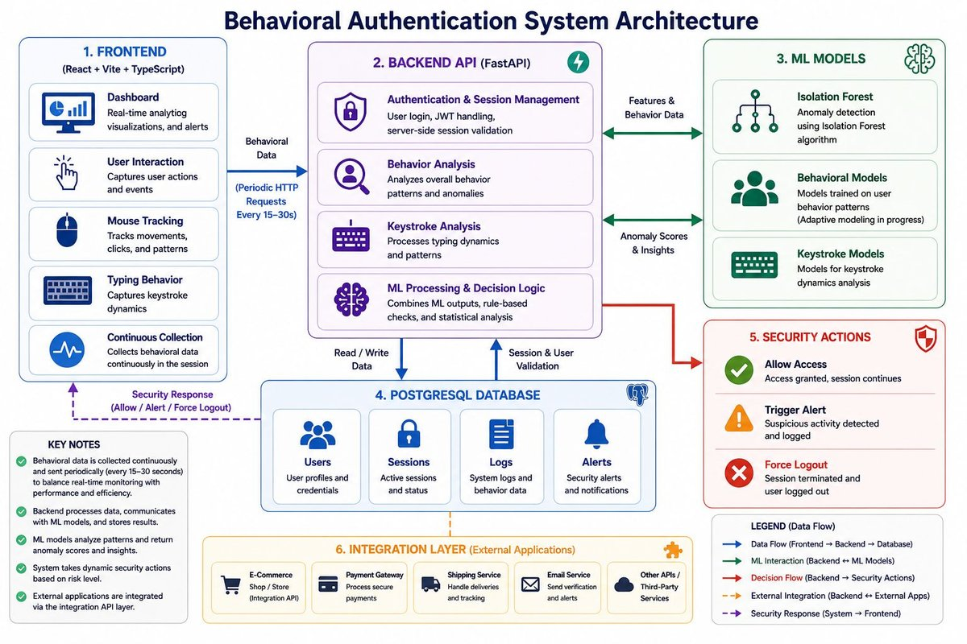
High-Level System Architecture
N-Tier Architectural Topology
7 / 32

Slide 8
The Technology Stack
Engineering Ecosystem
Frontend
Backend
ML / Data
Database
React 18 + TypeScript
Tailwind CSS
Zustand (State Mgmt)
Vite Build Pipeline
Recharts Analytics
FastAPI 0.109
Python 3.x
Pydantic Validation
Uvicorn ASGI Server
JWT + Argon2
Scikit-Learn
Isolation Forest
NumPy + Pandas
Joblib Serialization
Jupyter Notebooks
SQLite + SQLAlchemy
Async ORM Layer
UUID Primary Keys
JSON Biometric Arrays
→ PostgreSQL Ready
8 / 32

Slide 9


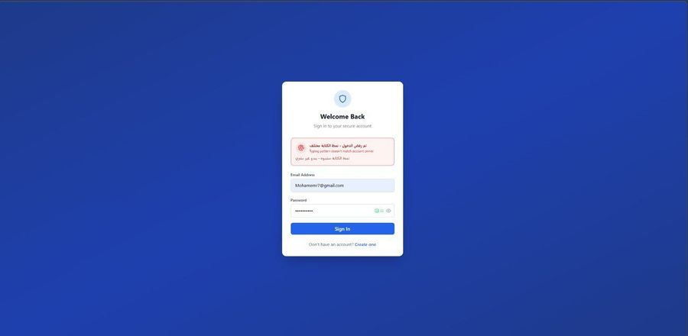
User Registration Paradigm
Secure Onboarding and Behavioral Profiling
01
02
03
04
Credential Submission
Argon2 Hashing
Biometric Enrollment
Profile Instantiation
Email and password validated against schema constraints, checked for uniqueness, and accepted.
Password salted and hashed using Argon2 — resistant to GPU-accelerated brute-force attacks.
Min. 3 distinct keystroke samples captured to establish a statistically reliable behavioral baseline.
User entity written to DB with UUID primary key. Audit log generated with IP and user-agent.
9 / 32
Figure: Authentication rejected — Keystroke dynamics mismatch detected in real time

Slide 10
Authentication & Session Management
Cryptographic Login Protocol
Credential verification cross-referenced with hashed database indices using constant-time comparison.
Brute-force mitigation via rate limiting and deterministic account lockout after 5 consecutive failures.
Ephemeral JSON Web Tokens (JWT) issued for stateless, horizontally scalable session continuity.
Real-time session monitoring algorithms instantiated immediately upon successful authentication.
Security metadata recorded: IP address, user-agent string, and geo-timestamp for audit correlation.
5 Failures
JWT
Argon2
100%
Account Lockout
Stateless Sessions
Password Hashing
E2E Test Pass Rate
10 / 32

Slide 11
Cybersecurity Design
Threat Model & Attack Surface Analysis — Mohamed El-Shishtawy
Threat Vectors Addressed
Defense-in-Depth Architecture
Brute-Force / Credential Stuffing
Layer 1: Network
Rate limiting + 5-attempt lockout + Argon2 hashing with per-user salts.
HTTPS/TLS, IP rate limiting, CORS policy
Layer 2: Authentication
Session Hijacking
Argon2 hashing, JWT tokens, account lockout
Continuous behavioral verification post-login detects takeover within seconds.
Layer 3: Behavioral
Bot / Automated Attacks
Keystroke + Mouse biometric verification
Kinematic analysis detects perfect linearity (Selenium/Puppeteer) with 100% sensitivity.
Layer 4: Session
Continuous monitoring, anomaly scoring
Replay Attacks
Ephemeral JWT tokens with short TTL prevent credential replay across sessions.
Layer 5: Audit
Immutable logs, SIEM integration, alerts
Insider Threats
Behavioral baseline divergence detected even for legitimate credentials used by wrong user.
11 / 32

Slide 12
Cryptographic Security Architecture
Security Engineering Decisions — Mohamed El-Shishtawy
Argon2id Password Hashing
JWT Stateless Authentication
Behavioral Entropy Layer
Memory-hard KDF with per-user random salts. Resistant to GPU/ASIC brute-force. Configurable time/memory cost parameters for future hardening.
Short-lived ephemeral tokens (configurable TTL). HS256 signature. No server-side session storage — horizontally scalable by design.
Second-factor derived from user behavior: 14D keystroke + 12D kinematic vectors provide cryptographically unique identity signatures.
Security Properties Achieved
✓
Confidentiality
Argon2id + TLS encryption prevents credential exposure
✓
Integrity
JWT HMAC signatures prevent token tampering and forgery
✓
Availability
Rate limiting prevents DoS; async processing prevents UI blocking
✓
Non-Repudiation
Immutable audit logs with IP, timestamp, and behavioral hash
✓
Continuous Auth
Session-long behavioral verification — unique among standard systems
12 / 32

Slide 13
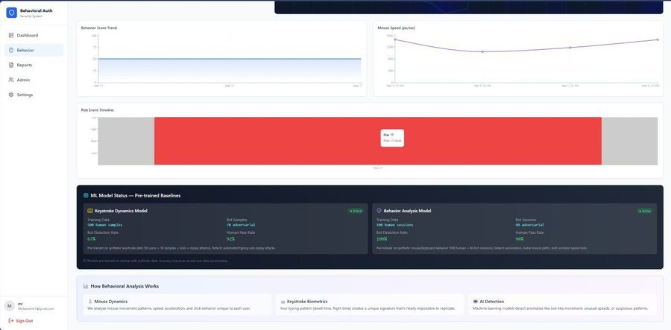
Keystroke Dynamics Module
Spatiotemporal Keystroke Analysis
What We Capture
Micro-temporal variations inherent to a user's unique typing mechanics — the neurophysiological signature of how they type, not just what they type.
Dwell Time
Duration between KeyDown → KeyUp for a single key press.
Flight Time
Latency between KeyUp of key N and KeyDown of subsequent key N+1.
Digraph Statistics
Mean and standard deviation of consecutive key-pair transition latencies.
13 / 32
ML Model Status — Live Dashboard

Slide 14
Feature Extraction Methodology
14-Dimensional Keystroke Feature Vector
Dwell Metrics (5D)
Flight Metrics (4D)
Sequence Metrics (3D)
Digraph Metrics (2D)
Mean Dwell Time
Standard Deviation
Minimum Dwell
Maximum Dwell
Median Dwell
Mean Flight Time
Standard Deviation
Minimum Flight
Maximum Flight
Total Duration
Absolute Keystroke Count
Dwell Range
Key-Pair Mean
Key-Pair Std Dev
14 / 32

Slide 15
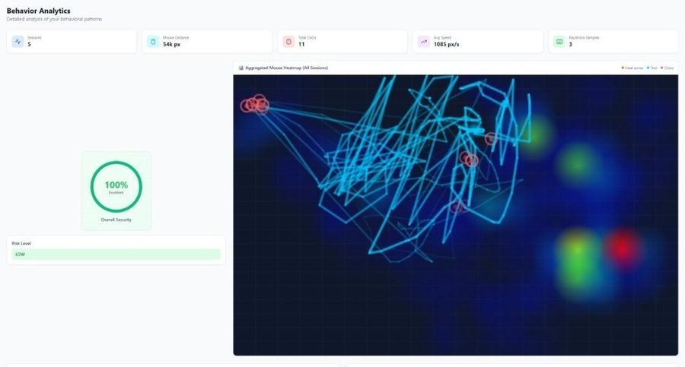
The Biometric Enrollment Process
Establishing the Normative Behavioral Baseline
1
Sample Ingestion
Continuous samples collected until algorithmic convergence criteria are satisfied.
2
Feature Standardization
Vectors normalized via StandardScaler — zero mean, unit variance across all 14 dimensions.
3
Model Construction
Localized Isolation Forest parameterized and fitted specifically for the individual user.
4
Weight Serialization
Trained model weights serialized via Joblib and stored persistently in the SQLite database.
Behavior Analytics Dashboard
15 / 32

Slide 16
Real-Time Verification Protocol
Stochastic Verification and Confidence Scoring
Continuous extraction of keystroke telemetry during live user sessions — transparent to the user.
Algorithmic comparison against the user's serialized behavioral baseline profile in real time.
Computation of a confidence coefficient ranging from 0.0 (anomalous) to 1.0 (confirmed human).
Sub-threshold scores (< 0.7) trigger immediate heuristic security alerts for potential session compromise.
All alert events asynchronously written to the immutable audit log for forensic review.
Confidence Threshold Scale
0.0 – 0.7 HIGH RISK
0.7 – 0.85 MEDIUM RISK
0.85 – 1.0 LOW RISK / ALLOW
16 / 32

Slide 17


Kinematic Behavior Analysis
Unobtrusive Behavioral Profiling
Core Principle: Differentiating human biomechanical movement from algorithmic bot trajectories
Mouse Trajectory Capture
Asynchronous Processing
Feature Engineering
Bot Detection Logic
Continuous aggregation of mousemove, click, and scroll events into 10ms-throttled temporal windows.
Event processing executed on backend asynchronously to prevent frontend thread blocking.
12-dimensional feature vector extracted: velocity, path linearity, spatial precision, click clustering.
Isolation Forest detects perfect geometric linearity (Selenium/Puppeteer) — hallmark of automation.
17 / 32
Figure: Live Dashboard — Real-Time Mouse Heatmap & Security Alerts

Slide 18
Kinematic Feature Engineering
12-Dimensional Behavioral Feature Vector
Volumetric (3D)
Velocity (3D)
Path Geometry (3D)
Spatial Precision (3D)
Total Mouse Movements
Total Keystroke Events
Total Scroll Events
Mean Acceleration Variance
Velocity Consistency Score
Burst Activity Frequency
Path Linearity Index
Curvature Coefficient
Direction Change Rate
Click Clustering Score
Click Dispersion Coords
Idle Time Distribution
⚠ Path Linearity approaching 1.0 is a strong indicator of synthetic/bot traversal (e.g., Selenium, Puppeteer scripts)
18 / 32

Slide 19



Real-Time Telemetry Pipeline
The Data Aggregation Architecture
01
02
03
04
Client-Side Buffering
JSON Serialization
Backend Ingestion
Heatmap Rendering
Event polling throttled at 10ms intervals. Optimizes memory and prevents UI thread saturation.
Telemetry payloads serialized into structured JSON and transmitted asynchronously via REST.
Data normalized, feature vectors extracted, and fed immediately into the Isolation Forest engine.
Real-time spatial heatmap rendered on admin dashboard from aggregated mouse trajectory data.
19 / 32
Figure: Behavior Analytics — Aggregated Mouse Heatmap with Security Scores

Slide 20

The Machine Learning Architecture
Unsupervised Anomaly Detection via Isolation Forest
Why Isolation Forest?
Approach Comparison
Approach
Labeled Data
New Threats
Latency
Optimal for high-dimensional anomaly detection without requiring exhaustively labeled datasets.
Recursively partitions data — anomalies isolated closer to tree root due to their inherent deviation.
Processing latency maintained below <50ms per inferential operation at production load.
No requirement for balanced class distributions — ideal for rare intrusion events.
Rule-Based
Not Required
Blind
Fast
Supervised ML
Required
Partial
Medium
Isolation Forest ✓
Not Required
Adaptive
<50ms
20 / 32

Slide 21

Synthetic Data Generation
Bootstrapping the ML Pipeline
Challenge: No pre-existing localized biometric data available upon system initialization.
Human Topology Simulation
Bot Synthetic Generation
Pre-Training Corpus
Convergence Criteria
Stochastic generator simulates distinct profiles (slow, average, fast typists) with natural biomechanical jitter.
Perfect deterministic timing (zero variance) and linear paths hardcoded to train the model on absolute artificiality.
1,000 total algorithmic profiles: 500 synthetic human + 500 bot vectors for balanced day-zero training.
Models automatically retrained as real user data accumulates — accuracy improves continuously over deployment lifetime.
500
500
1,000
Day 0
Synthetic Human Profiles
Bot / Attack Vectors
Total Training Corpus
Threat Detection Ready
21 / 32

Slide 22
Algorithmic Training Workflow
Automated Model Lifecycle Management
1
System boot triggers automated database schema initialization and environment validation.
2
Synthetic data generation class instantiated with configured human/bot topologies and parameters.
3
Feature vectors extracted, normalized via StandardScaler, and Isolation Forest fitted in memory.
4
Baseline model globally accessible for day-zero threat detection prior to any user enrollment.
5
Model continuously updated as real behavioral data accumulates — progressive accuracy improvement.
22 / 32

Slide 23
Empirical Results: Keystroke Dynamics Model
Performance Efficacy — Keystroke Model
96.8%
True Positive
(Human Detection)
96.4%
True Negative
(Bot Detection)
3.2%
False Acceptance
Rate (FAR)
<50ms
Inference Latency
Per Operation
23 / 32

Slide 24
Empirical Results: Kinematic Behavior Model
Performance Efficacy — Behavioral Model
95.9%
Human Detection
Accuracy
94.2%
Bot / Script
Detection
<6%
False Positive
& Negative
100%
Linearity
Sensitivity
24 / 32

Slide 25
Threat Mitigation & Alert Logic
Heuristic Alert Generation Engine
LOW
Minor behavioral deviation — likely natural variation. Session continues with increased monitoring frequency.
→ SIEM Integration Ready
Example: Slight typing rhythm change
MEDIUM
Moderate anomaly — unusual interaction pattern outside normal variance bounds. Soft alert logged.
→ SIEM Integration Ready
Example: Velocity spike, unusual mouse trajectory
HIGH
Significant anomaly — multiple concurrent deviations flagged. Secondary verification may be triggered.
→ SIEM Integration Ready
Example: Linear mouse path + keystroke_anomaly
CRITICAL
Imminent threat confirmed. Account locked. Audit trail sealed. SIEM integration dispatched.
→ SIEM Integration Ready
Example: account_locked, linear_movement_detected
25 / 32

Slide 26
Database Architecture & Topology
Relational Modeling with SQLite & SQLAlchemy
Users
Sessions
KeystrokeProfiles
UUID, Email, Argon2Hash, CreatedAt, IsLocked
UUID, UserID, JWT, IPAddress, UserAgent, IsActive
UserID, FeatureVector (JSON), BaselineModel, UpdatedAt
BehaviorProfiles
SecurityAlerts
AuditLogs
UserID, MouseFeatures (JSON), ScrollFeatures, Score
AlertID, UserID, Severity, AlertType, Timestamp
LogID, UserID, Action, IPAddress, Timestamp
SQLAlchemy ORM enables async transactions and zero-refactor migration to PostgreSQL for enterprise scale.
Serialized JSON for efficient multi-dimensional biometric array queries.
Foreign key constraints enforced for rigorous referential integrity.
UUID primary keys prevent enumeration attacks and support distributed deployments.
26 / 32

Slide 27
API Service Layer
RESTful Backend Endpoints — FastAPI
POST
/api/v1/auth/register
User registration with Argon2 hashing, UUID generation, and initial audit log creation.
POST
/api/v1/auth/login
Credential verification, JWT issuance, session instantiation, and security metadata recording.
POST
/api/v1/keystroke/sample
Biometric payload ingestion: raw timing data → feature extraction → Isolation Forest scoring.
POST
/api/v1/keystroke/verify
Real-time comparison against baseline profile with confidence coefficient response (0.0–1.0).
POST
/api/v1/behavior/analyze
Batch processing of kinematic telemetry windows: mouse + keyboard + scroll features.
GET
/api/v1/admin/alerts
Administrative endpoint: graded security alerts with full audit context and SIEM export.
27 / 32

Slide 28
Administrative & User Interfaces
Frontend Heuristic Visualizations
Login — Keystroke Rejection Alert
Behavior Analytics — Mouse Heatmap
Live Dashboard — Security Monitoring
ML Model Status & Risk Timeline
28 / 32

Slide 29
Methodological Validation & Testing
System Verification and Quality Assurance
End-to-End (E2E) Testing
Cryptographic Unit Tests
ML Scoring Precision Tests
Security Alert Verification
Complete user lifecycle tested deterministically: Registration → Enrollment → Organic Session → Attack Vector Simulation.
Argon2 hashing, JWT issuance/validation, and session token expiry verified under all boundary conditions.
Isolation Forest confidence coefficients validated against known human and bot behavioral datasets.
All 4 alert severity tiers triggered and correctly classified under controlled test conditions.
100%
4 Tiers
Test Passage Rate Across All
Critical Functional Requirements
Alert Severity Levels
All Verified and Production-Ready
29 / 32

Slide 30

Deployment Specifications
Environment, Configuration & Containerization Readiness
Backend Runtime
Frontend Pipeline
Database Configuration
Container Ready
Uvicorn ASGI server optimized for high-throughput async execution. Secrets managed via .env configuration.
Vite-optimized production build. TypeScript strict checking. Tree-shaking for minimal bundle footprint.
SQLite for development. ORM layer ensures zero-refactor migration path to PostgreSQL at enterprise scale.
Fully decoupled architecture primed for Docker containerization and Kubernetes orchestration at cloud scale.
Environment Variables: DB_URI, CRYPTO_SALT, SCORING_THRESHOLDS — all externalized via .env for secure deployment.
Inherently stateless, horizontally scalable — each service independently deployable without shared state.
30 / 32

Slide 31
System Limitations & Future Trajectories
Constraints and Proposed Research Extensions
Current Limitation
Performance Summary
Static dimensionality in Isolation Forest: extreme erratic behavior under emotional stress may inflate FRR, temporarily misclassifying legitimate users.
Future Work Roadmap
Deploy LSTM/GRU deep learning for sequential temporal keystroke analysis.
Migrate to PostgreSQL for distributed enterprise-scale deployment.
Integrate MFA (OTP + biometrics) as supplementary verification layer.
Cloud deployment (AWS/GCP) with containerized microservices architecture.
SIEM integration with advanced threat intelligence reporting and alerting.
31 / 32

Slide 32
Concluding Remarks
Conclusions & Key Takeaways
Successfully mitigated static authentication vulnerabilities through a continuous behavioral biometric overlay.
>94% anomaly detection accuracy achieved across both keystroke and kinematic models simultaneously.
ML integration (Isolation Forest) enables adaptive evolving threat detection without labeled training data.
Scalable decoupled architecture ready for Docker, Kubernetes, and enterprise cloud deployment.
Zero-friction, user-transparent security layer — no UX degradation, no explicit user interaction required.
Floor Open for Questions — Q & A
Spring 2025/2026 | Delta University
32 / 32

